Slide 1

Chapter two
Intelligent Agents
CoSC 412
Ashenafi W.

Slide 2
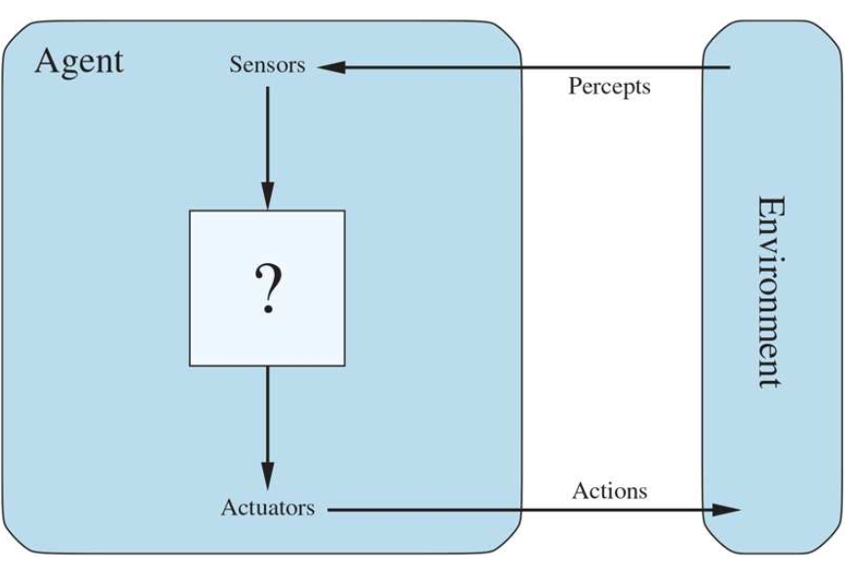
Intelligent Agents
Agent is one that:
  Perceives via sensors (Observes its environment) – Camera, any other input
  Takes action in its environment via its actuators
Environment is that which is outside of the agent but affects the agent and is also affected by it
  Limited part of the entire universe (for obvious purposes)
Examples:
  Humans can be thought of as agents
    Inputs – eyes, ears
    Actuators/effectors – Hands, legs
  Robotic agent
    Inputs/sensors – cameras, infrared sensors, …
    Actuators – motors
  Software Agent
    Inputs – from keyboards, mouse, packets, etc.
    Outputs – manipulate files, display info, etc.
What do you think should come here?

Slide 3
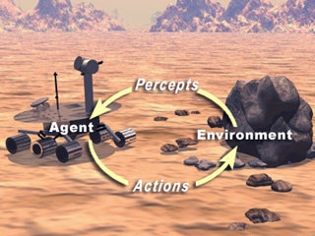
Intelligent Agents – Some terminologies
Percepts:
  The content an agent’s sensors are perceiving
Percept Sequence:
  Complete history of everything the agent has ever perceived (up to the present)
In a give situation/scenario an agent makes a decision based on its
  built in knowledge (that which was original)
  Precept sequence (learned over time)
Agent function which maps any given percept
sequence to an action describes an agent’s behavior
  Externally it’s a table of actions (a list)
  Internal to the agent the process is a program

Slide 4
Example of Agent Types
Agent type
Percepts
(input)
Actions
Goals
(output)
Environment
Medical diagnosis system
Symptoms, findings, patient's answers
Questions, tests, treatments
Healthy patients, minimize costs
Patient, hospital
Satellite image analysis system
Pixels of varying intensity, color
Print a categorization of scene
Correct categorization
Images from orbiting satellite
Part-picking robot
Pixels of varying intensity
Pick up parts and sort into bins
Place parts in correct bins
Conveyor belts with parts
Refinery controller
Temperature, pressure readings
Open, close valves; adjust temperature
Maximize purity, yield, safety
Refinery
Interactive English tutor
Typed words
Print exercises, suggestions, corrections
Maximize student's score on test
Set of students

Slide 5
How should an agent act?
Rational agent
  One that does the right thing.
  if the system achieves the objective assigned
Which actions are correct? (Rationalistic Action approach)
  The actions that cause the agent to be most successful
Therefore, success of an agent should be measured in someway
    What is rational at any given time depends on four things:
      The performance measure defining the criterion of success
      The agent’s prior knowledge of the environment
      The actions that the agent can perform
      The agent’s percept sequence up to now

Slide 6

How should an agent act? - Continued
For each possible percept sequence, a rational agent should select an action expected to maximize its performance measure,
  Given the evidence provided by the percept sequence and whatever built-in knowledge the agent has
  For example, during exam objective is to maximize marks, based on the questions on the paper & your knowledge

Slide 7

Learning
Autonomy
Does a rational agent depend on only current percept?
  No, the past percept sequence should also be used. this is called learning
  After experiencing an episode (event), the agent should adjust its behaviors to perform better for the same job next time.
If an agent just relies on the prior knowledge of its designer rather than its own percepts then the agent lacks autonomy
A rational agent should be autonomous - it should learn what it can to compensate for partial or incorrect prior knowledge.
E.g. a clock
  No input (percepts)
  Run only but its own algorithm (prior knowledge)
  No learning, no experience, etc.

Slide 8
Software Agents
Sometimes, the environment may not be the real world
  E.g. flight simulator, video games, Internet
  They are all artificial but very complex environments
  Those agents working in these environments are called Software agent (softbots) Because all parts of the agent are software

Slide 9
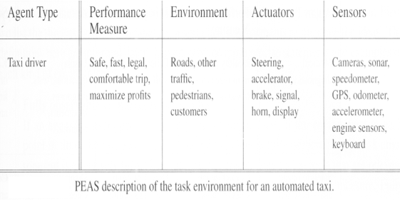
Task Environments
Sometimes, the environment may not be the real world
  E.g. flight simulator, video games, Internet
  They are all artificial but very complex environments
  Those agents working in these environments are called Software agent (softbots) Because all parts of the agent are software
Specifying the task environment, PEAS description as fully as possible
    Performance measure
    Environment
    Actuators
    Sensors
  In designing an agent, the first step must always be to specify the task environment as fully as possible.

Slide 10
Task Environments – Continued
Performance measure
  How can we judge the automated driver?
  Which factors are considered?
        getting to the correct destination
        minimizing fuel consumption
        minimizing the trip time and/or cost
        minimizing the violations of traffic laws
        maximizing the safety and comfort, etc.
Actuators
  Control over the accelerator, steering, gear shifting and braking
  A display to communicate with the customers
Environment
  A taxi must deal with a variety of roads
  Traffic lights, other vehicles, pedestrians, stray animals, road works, police cars, etc.
  Interact with the customer
Sensor
  camera,

Slide 11

Properties of task environments - Continued
Fully observable vs. Partially observable
  Fully observable
    If an agent’s sensors give it access to the complete state of the environment at each point in time then the environment is effectively and fully observable
  Partially observable
    If an agent’s sensors doesn't give it access to the complete state of the environment.
    Because of noisy and inaccurate sensors or parts of the state are simply missing from the sensor data.
    E.g. A local dirt sensor of the cleaner cannot tell Whether other squares are clean or not.
Deterministic vs. stochastic
    Next state of the environment Completely determined by the current state and the actions executed by the agent, then the environment is deterministic,
    If the environment is not completely determinable/erratic, then it is Stochastic.
    E.g. Cleaner and taxi driver are: Stochastic because of some unobservable aspects: noise or unknown

Slide 12
Properties of task environments - Continued
Episodic vs. sequential
  An episode = agent’s single pair of perception & action
  The quality of the agent’s action does not depend on other episodes
  Every episode is independent of each other
  Episodic environment is simpler
  The agent does not need to think ahead
  Sequential
  Current action may affect all future decisions
  E.g. Taxi driving and chess.
Static vs. dynamic
  A dynamic environment is always changing over time
      E.g., the number of people in the street
  Static environment
      E.g. the destination
  Semi dynamic
    environment is not changed over time
    but the agent’s performance score does

Slide 13
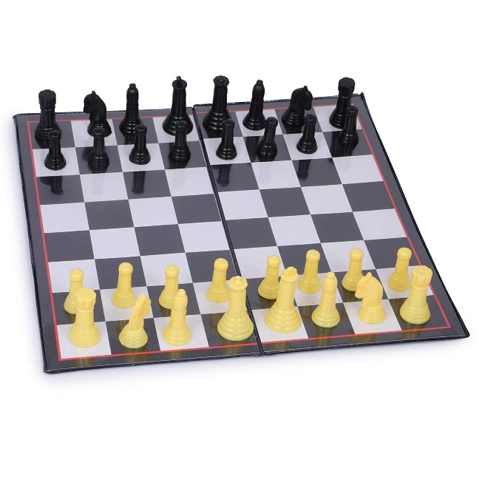
Properties of task environments - Continued
Discrete vs. continuous
  If there are a limited number of distinct states, clearly defined percepts and actions, the environment is discrete
    E.g. Chess game
  Continuous environment
    E.g. Taxi driving
Known vs. unknown
  In known environment, the outcomes for all actions are given.
    Example: solitaire card games.
  If the environment is unknown, the agent will have to learn how it works in order to make good decisions.
    Example: new video game.

Slide 14
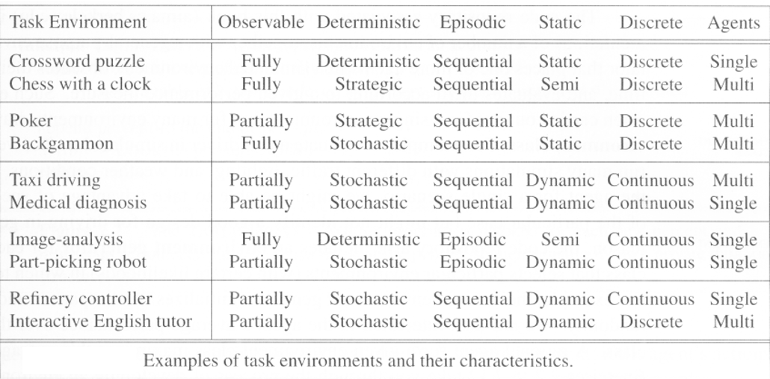
Properties of task environments - Examples

Slide 15
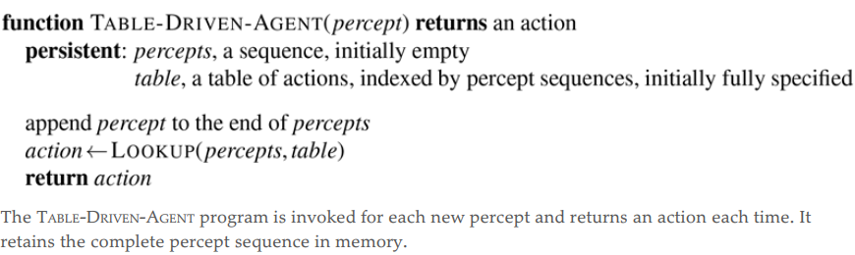
Structure of AI Agents
An intelligent agent is composed of
  Architecture – underlying machinery the AI agent executes/performs its function
  Agent Function – maps a percept/environmental input into a an action
    f:P* → A
And then there’s the agent program, which implements the agent function by running on the agent architecture to produce f
  Input for Agent Program - Only the current percept
  Input for Agent Function - The entire percept sequence
    The agent must remember all of them
  Implement the agent program as a look up table (agent function)
An agent based on a prespecified lookup table.
  It keeps track of the percept sequence and just looks up the best action.

Slide 16
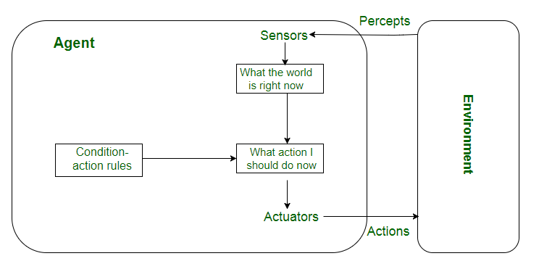
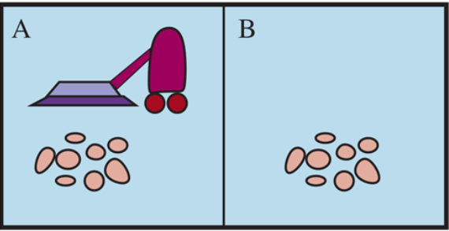
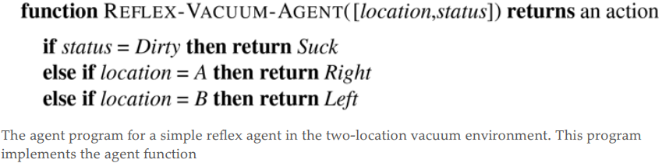
Types of agent programs
Based on degree of perceived intelligence (from our perspective) and capability
  Simple Reflex Agents: act only upon the current percept (don’t consider percept seq.)
    Here agent function is based on the condition-action rule (maps a state to an action)
    If the condition is true, then the action is taken, else not
    Agent function works only in a fully observable environment
    E.g. – Vacuum agent (has dirt sensor and location sensor)
  How should the vacuum behave if it’s location sensor fails? (Doesn’t know where it’s head is)
  Some sort of guessing is needed –
    If clean then randomly choose left/right

Slide 17
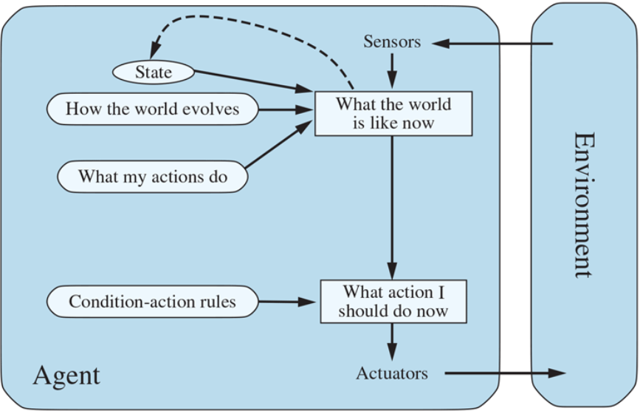
Types of agent programs
Based on degree of perceived intelligence (from our perspective) and capability
The most effective way to handle partial observability is for the agent to keep track of the part of the world it can’t see now
  Model-based reflex agents: have
    Internal state: depends on the percept history and thereby reflects at least some of the unobserved aspects of the current state
    Transition Model: Knowledge about how the world works
      Effects of the agent’s actions
      How the world evolves independently of the agent
    Sensor Model: perception of the world
  Model based agent uses transition and state model to keep track of its environment – given the fidelity of its sensors

Slide 18
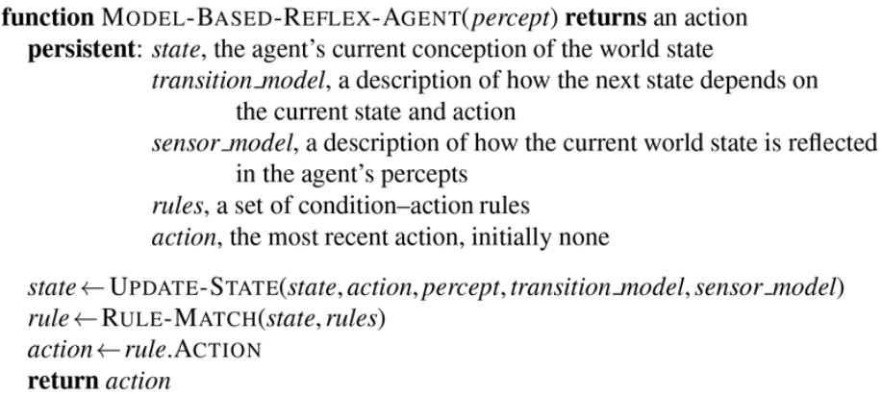
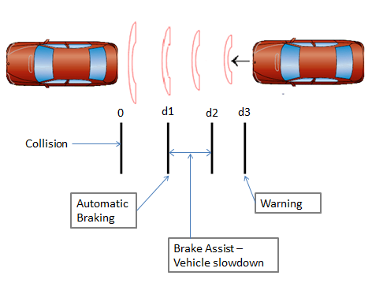
Types of agent programs
Based on degree of perceived intelligence (from our perspective) and capability
  Model based Reflex Agent – Continued
    Transition Model:
    For example, when the agent turns the steering wheel clockwise, the car turns to the right,
    When it’s raining the car’s cameras can get wet
    Sensor Model:
    For example, when the car in front initiates braking, one or more illuminated red regions appear in the forward-facing camera image, and, when the camera gets wet, droplet-shaped objects appear in the image partially obscuring the road
    Internal State:
    For example: internal state is not too extensive—just the previous frame from the camera, allowing the agent to detect when two red lights at the edge of the vehicle go on or off simultaneously

Slide 19
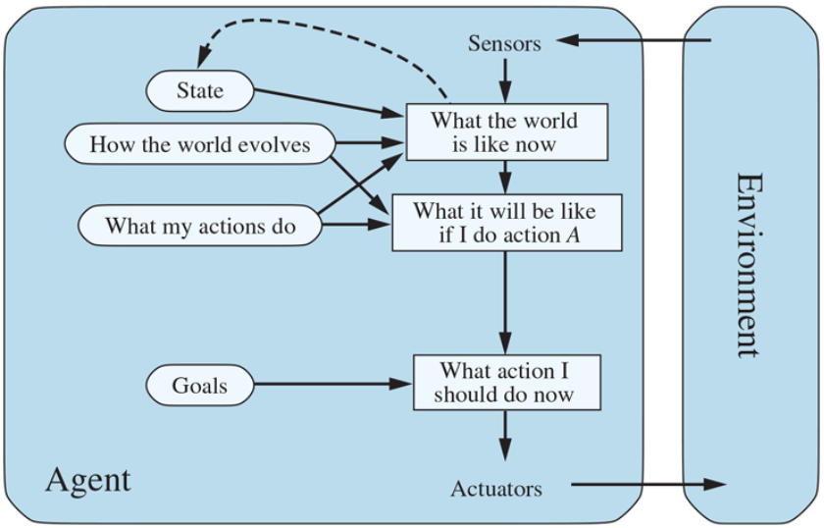
Types of agent programs
Based on degree of perceived intelligence (from our perspective) and capability
  Goal-based Agent: as well as a current state description (Model-based), the agent needs some sort of goal information that describes situations that are desirable
  Combine model and goal to achieve its objective (reach it’s goal)
  Selecting an action based on goals:
    From a single action (simple)
    Combination of several actions required (Search and planning involved)
  Decision making of this kind is fundamentally different from the condition:
    Consider both “What will happen if I do such-and-such?” and “Will that make me happy?
    E.g. Car braking in reflex agents vs goal based agents

Slide 20
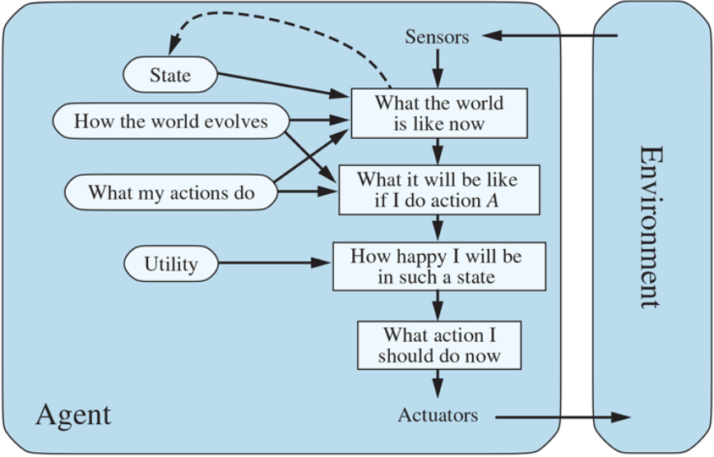
Types of agent programs
When there are several goals
  None of them are achieved certainly
  Utility provides a way for the decision-making
Based on degree of perceived intelligence (from our perspective) and capability
  Utility-based Agent: here we’re concerned not only about goals but the quality of action taken
    A more refined action – performance metrics required (utility function)
    Use a world model along with utility function that influences its preferences among the states of that world.
    It chooses the action that leads to the best expected utility
  Advantages:
  When there are conflicting goals,
    Only some of the goals but not all can be achieved
    Utility describes the appropriate trade-off

Slide 21
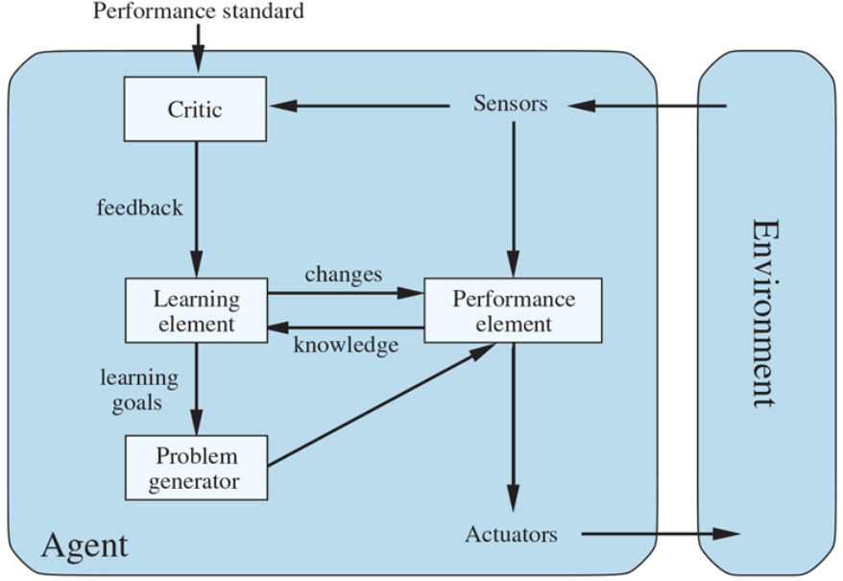
Types of agent programs
Learning allows the agent to operate in initially unknown environments and to become more competent than its initial knowledge alone might allow
Based on degree of perceived intelligence (from our perspective) and capability
  Learning Agent:
    is an agent that augments the performance element which determines actions from percept sequences with: (Four conceptual components)
  Learning element : makes improvements to the agent’s knowledge
  Critic: gives feedback to the learning element based on an external performance standard (from user or examples, good or not?)
  Problem generator: suggests actions that lead to new and informative experiences.
  Performance element: Selecting external actions or what we took for the whole agent above.

